Slide 1
Working Group:
Uncertainties in
Ocean Colour Remote Sensing
Status Report
Prepared by F. Mélin
21st IOCCG Committee Meeting
1-3 March 2016, Santa Monica, CA

Slide 2
Original Membership:
M. Bouvet, ESA
P. Chauhan, ISRO, India
R. Doerffer, HZG/BC, Germany (co-chair)
S. Dutkiewicz, MIT, USA
H. Kobayashi, Univ. Yamanashi, Japan
E. Kwiatkowska, EUMETSAT
F. Mélin, JRC (co-chair)
M. Wang, NOAA, USA
J. Werdell, NASA, USA
Additional contributions expected/received from:
B. Bulgarelli, JRC
B.A. Franz, NASA, USA
R. Frouin, SIO, USA
C. Hu, USF, USA
T. Jackson, PML, UK
E. Jones, MIT, USA
E. Karaköylü, NASA, USA
S. Lavender, Telespazio, UK
V. Martinez, PML, UK
G. Neukermans, Takuvik, Canada
M.-F. Racault, PML, UK
E. Rehm, Takuvik, Canada
H.U. Solanski
K. Turpie, UMBC, USA
…

Slide 3
Time Line:
Establishment of WG: Oct. 2011
Draft working plan: Dec. 2011
First draft version (outline + text for first 2 chapters): Dec. 2013
IOCS, San Francisco - session on uncertainties: Jun. 2015
WG 1-day meeting (San Francisco): Jun. 2015
Draft outline revised (based on meeting): Jun/Jul. 2015
New draft circulated among WG: Feb. 2016

Slide 4
Session at IOCS, Jun. 2015
Understanding and Estimating Uncertainty in Ocean Colour Remote Sensing Data and Derived Products
Co-chairs: E. Boss, R. Doerffer, S. Maritorena, F. Mélin, K. Turpie, J. Werdell
Status in the field for ocean colour, theory
Review of methods proposed for R_{RS} and derived products:
- class-based approach;
- machine learning;
- uncertainty propagation;
- algorithm-based approach;
- colocation.
Recommendations (to be taken into account in the report):
- more dialogue with developers/users on the issue of uncertainty;
- extend the work on uncertainty propagation;
- more work to understand pros/cons of individual methods;
- look at methods developed in other communities;
- investigate propagation of uncertainties through Level-2/3/…;
- adopt an unambiguous language for communicating on uncertainties based on international standards.

Slide 5
WG Meeting, 19 Jun. 2015
Attendees:
P. Chauhan, S. Dutkiewicz, B. Franz, E. Karaköylü, H.Kobayashi, E. Kwiatkowska, F. Mélin, M. Wang, J. Werdell
Reviewed the WG Terms of Reference
Revised the outline of the report and listed issues to be covered
Identified the contributions and leads

Slide 6
Working Group Terms of Reference:
analyse factors which determine uncertainties for various water types;
analyse the problem of uncertainties for different product types, such as IOPs, K-values, z90 depth, concentrations;
analyse the problem of uncertainty propagation in L3 and merged products;
review, analyze and document methods, which allow to determine out-of-scope conditions and uncertainties including flagging;
develop and compile a data set to test uncertainty and out-of-scope algorithms,
recommend procedures to be implemented in ground processors and formats to present errors / uncertainties in data products;
summarize the results and recommendations in the form of an IOCCG report.

Slide 7
Current outline
Introduction
Sources of uncertainties
Uncertainty Estimates
4.Representation and distribution of uncertainties
5. Requirements from different applications of Ocean Colour data
6. Recommendations
Notes:
PP: primary production

Slide 8
Chapter 2. Sources of uncertainties
2.1 Uncertainties of input data
TOA data
Ancillary data
2.2 Uncertainties associated with models and algorithms
Atmosphere (aerosols, Rayleigh…)
Effects of clouds, ice, land (adjacency…)
Sea surface (glint…)
Optical properties of water constituents
Vertical distribution of water constituents
Relationship between IOPs and AOPs and bidirectional effects
Chapter 3. Uncertainty Estimates
3.1 Use of field observations
3.2 Methods for identifying out-of-scope conditions and estimating uncertainties of ocean
colour products
3.3 Current knowledge on uncertainties (R_{RS}, derived marine products, aerosols, PP, PAR)
3.4 Verification of uncertainties

Slide 9
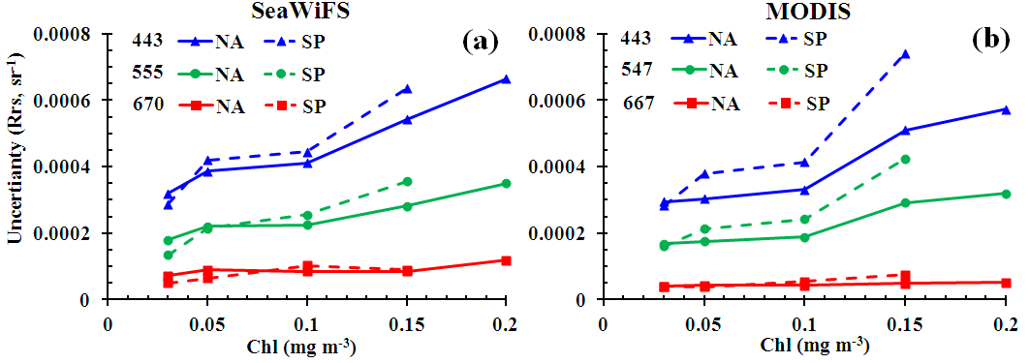
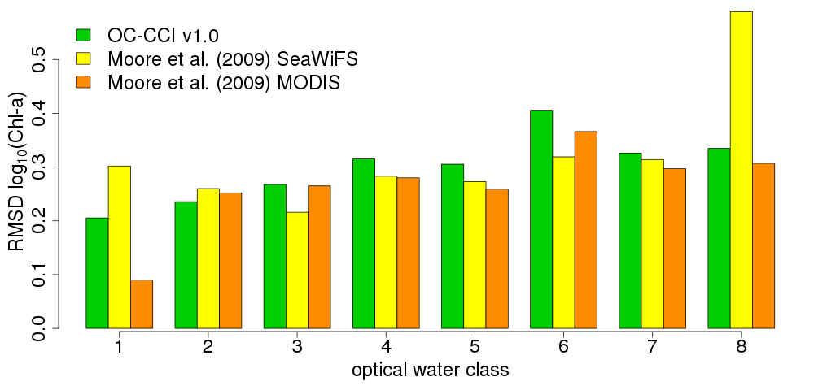
Methods currently considered in Section 3.2 of Chapter 3
Uncertainty estimates from algorithm construction
Clear-water approach (algorithm-based)
The Clear-water approach relies on the comparison the outputs of 2 Chla algorithms (i.e., OC4 and OCI color-index). R_{rs} is assumed error-free when the 2 algorithms provide the same Chla values. The R_{rs} uncertainties are then determined as the standard deviation of R_{rs} generic values with respect to the reference error free R_{rs} for specific Chla values determined with OCI.
Uncertainties of SeaWiFS and MODIS/Aqua R_{rs} data for the
North Atlantic (NA) and South Pacific (SP); Hu et al. (RSE 2013).
Class-based approach
In a class-based approach, validation statistics are first defined for each class (or optical water type) using a match-up data base linking satellite and in-situ data. Then any input data (e.g., R_{rs} ) can be classified and its validation statistics associated with the relevant class. So, if an input is found as fully belonging to a class, its uncertainty value is that of that class.
RMSD for log(Chl) from match-ups and optical water types (Moore et al. 2009); Sathyendranath et al. (in prep)
Notes:
Algorithm construction: e.g. RMS of a regression for an empirical algorithm

Slide 10
Outputs of non-linear inversion methods
Bayesian approach
Use of simulated data
Analytical uncertainty propagation
In the analytic approach the expected uncertainty affecting R_{rs} is propagated to the derived products (e.g., Chla).
Relationship between an error on R_{RS} of different signs for the blue and green bands input to the OC4v6 maximum-band-ratio algorithm

Slide 11
Comparison of satellite products
Collocation techniques
Collocation relies on the accumulation of matching data from 2 or more satellite data sets. A mathematical development leads to the computation of the part of the uncertainty budget associated with random effects and called σ.
R_{rs} uncertainty associated with random effects
(Mélin et al., RSE 2016)
log(Chl) uncertainty associated with random effects (Mélin, IEEE 2010)
Methods for specific products (e.g., PFTs, ….)

Slide 12
Chapter 4. Representation and distribution of uncertainties
4.1 Out-of-scope flags
4.2 Uncertainty distribution
4.3 Current distributions
Chapter 5. Requirements from different applications of Ocean Colour data
5.1 Modeling Community
5.2 Climate Research
5.3 Environmental Monitoring
5.4 Phenology Studies
5.5 Fisheries Applications
Notes:
Chap. 4: current distributions: projects actually distributing uncertainty values (e.g., CCI).
Chap. 5: well covered

Slide 13
New Time Line:
Complete draft: June 2016
Final draft: September 2016
Notes:
Time line postponed wrt previous plans
Contributions still slow in coming….

